Slide 1

Welcome
26/08/2019
Text Classification
Presented By-Sakshi Bharuka
Guided By-Prof. Amruta Joshi

Slide 2
CONTENT
Introduction
Literature Survey
Brief on System
Conclusion
References

Slide 3
What is Text Classification
Text classification is the process of assigning tags or categories to text according to its content.
Text classifiers can be used to organize, structure, and categorize pretty much anything.
It’s one of the fundamental tasks in Natural Language Processing (NLP) with broad applications such as sentiment analysis, topic labeling, spam detection, and intent detection.
Some of the most popular machine learning algorithms for creating text classification models include the naive Bayes family of algorithms, support vector machines, and deep learning.

Slide 4
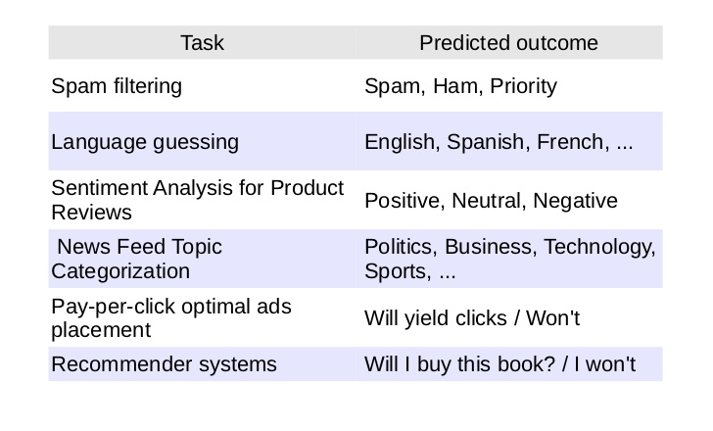
Applications

Slide 5
Literature Survey
Information Retrival (IR)
Natural Languuage Processing (NLP)
Information Extraction from Text
Text Sumarization

Slide 6
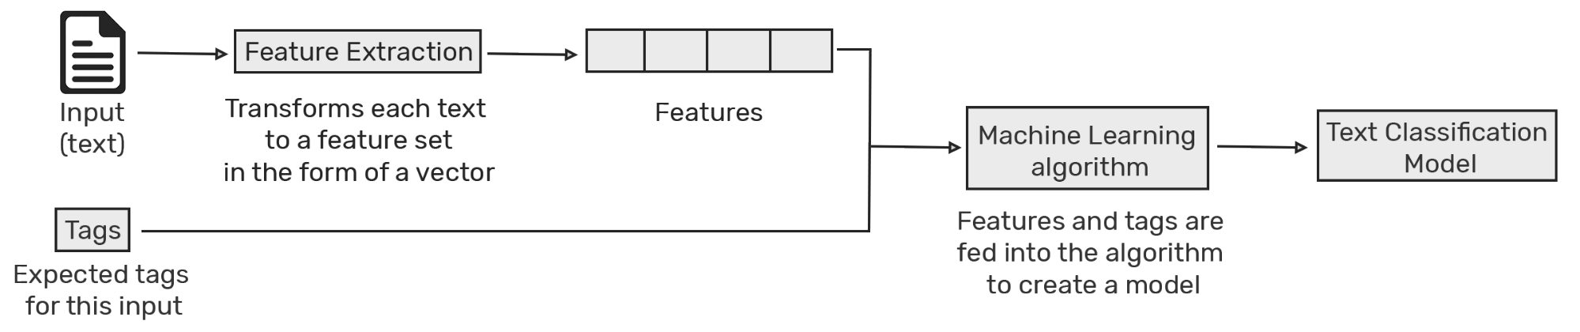
Brief on System
Text classification is the task of assigning a set of predefined categories to free-text.
Steps for text classification:

Slide 7
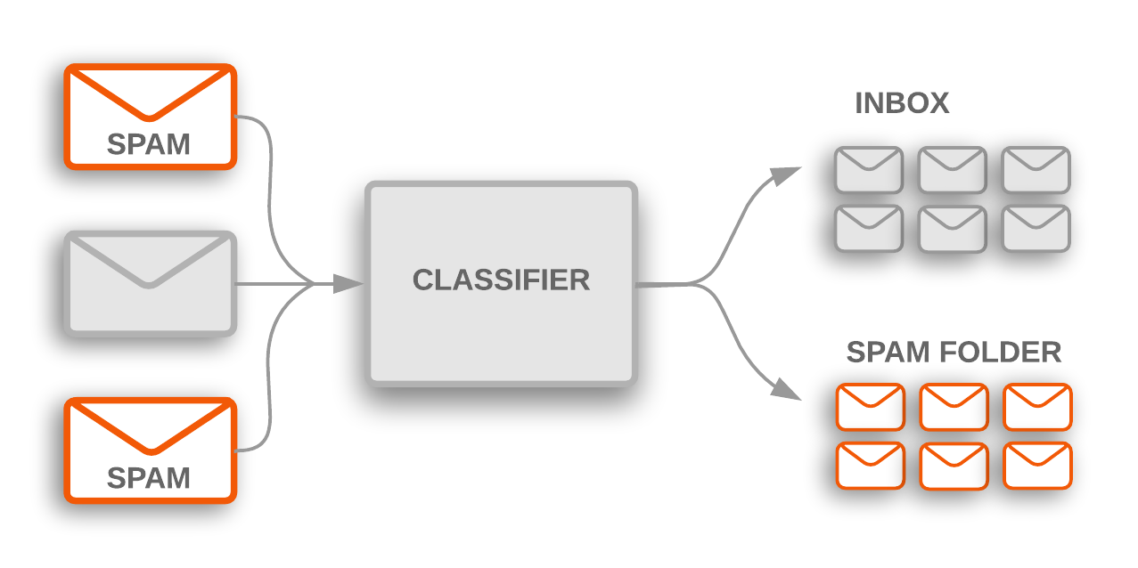
Example

Slide 8
Conclusion
The growing use of the textual data which needs text mining, machine learning and natural language processing techniques to organize and extract pattern and knowledge from the documents.
Different algorithms perform differently depending on data collection. However, to the certain extent SVM with term weighted VSM representation scheme performs well in many text classification tasks

Slide 9
References
Sebastiani, F.: Machine learning in automated text categorization. ACM Comput. Surv. 34(1), 1–47 (2002)CrossRef Google Scholar
Wikipedia
https://monkeylearn.com/text-classification/

Slide 10
THANK YOU

